Slide 1
NDIA 2014 SED Planning Mtg. Issues
Richard (Dick) L. Engwall
President RLEngwall & Associates
Manufacturing SME
rlengwall@verizon.net
(410) 571-8623

Slide 2
NDIA SED Planning Mtg. 12/11-12/13 at Raytheon Rosslyn, VA
As a charter member of the NDIA SED for many years Dick Engwall was invited to their Annual Planning Mtg.
All SED project chairpersons and selected staffs participated
First Time Manufacturing Participated in SED Mtg.
Key DoD SE Experts Presented Their 2014 Plans/Needs

Slide 3
NDIA Manufacturing MRL Needs Presented
Dick Engwall discussed and subsequently provided the following “Designing for the “Illities” Needs white paper”:
  The following has been the MRL Deskbook IPPD Core Issues addressing affordability in the MRL Deskbook Item B. Design, B.1 Producibility Program Track

Slide 4
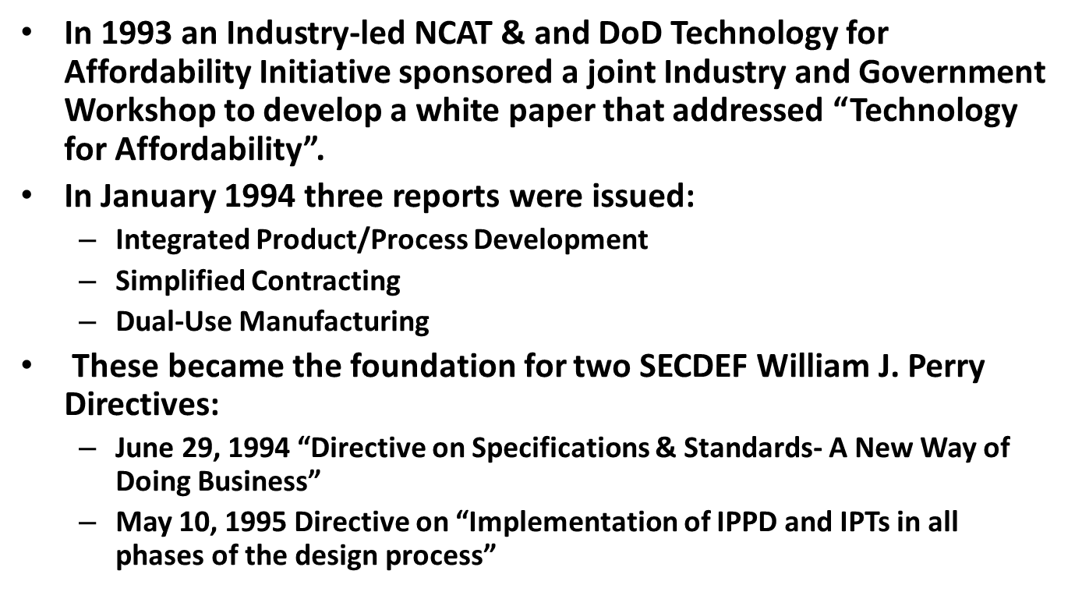
Integrated Product & Process Development (IPPD)

Slide 5
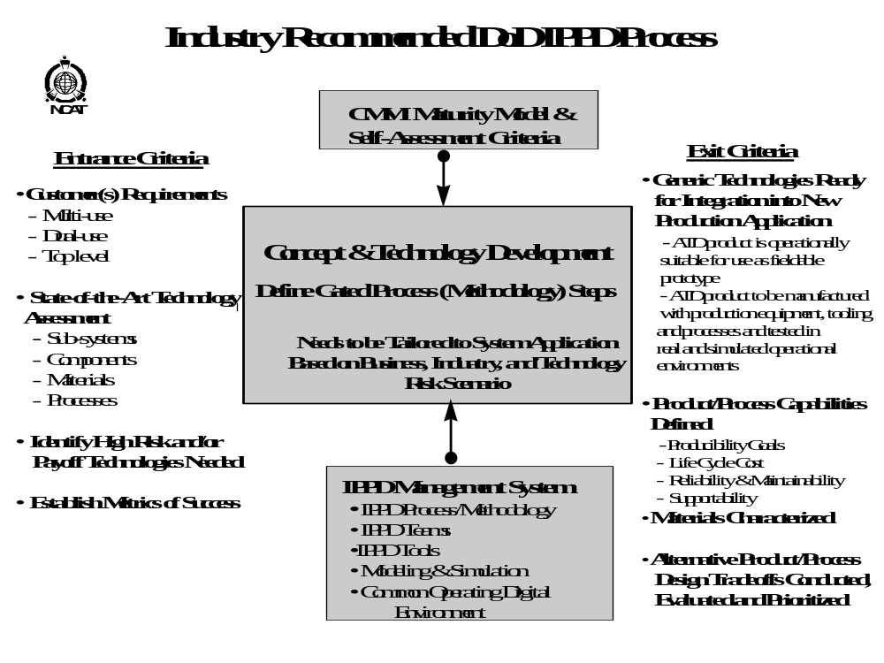

Slide 6
Designing for the “Illities”
Manufacturability
Producibility
Supportability (in the broadest sense)
  Includes Reliability, Testability and Supportability

Slide 7
Design for Manufacturability
Design for commonality and standardization-
fewer parts
Perform comprehensive Technology
Assessment, including commercial industrial
applications
Design for Multi-Use and Dual-Use applications
Design for modularity and plug compatible
interface/integration
Design for flexibility, adaptability, and “robust
design”
Utilize reliable processes and materials
Utilize IPPD management process and IPTs
Utilize IPPD scientific tools and methodologies

Slide 8
Design for Producibility
Design to specific Cp-CpK process control parameters- six sigma
Perform material characterization analysis
Perform variability reduction analysis- Taguchi, DOE
Develop critical materials and processes before selecting product design
Utilize pervasive modeling & simulation for product and process design tradeoffs
Design for/employ closed-loop process-control on critical items

Slide 9
Design for Reliability, Testability, Maintainability, and Supportability
Evaluate device-level reliability- materials and components, hardware/software integration, process related issues
Develop techniques to accelerate and verify technology maturity
Utilize IPPD tools and IPTs- self checking software design, validation and verification, rapid prototyping, accelerating life testing, improved reliability analysis and prediction techniques, LCC analyses
Develop techniques for error detection, correction, and recovery
Design-in testability
Design-in ease of supportability and extendibility
Strive for defect-free manufacturing

Slide 10
Next Actions
Noted that Manufacturing Industry (NDIA Mfg. Div.) and Government (Services JDMTP & Govt. MRL WG are jointly working together:
Requested the NDIA SED to review our plan and ask for their “critique and evaluation for 2014
  How we might work together better?
  What other technologies we should be looking at that we aren’t doing to help them?
  Any other issues?

